Slide 1
SoHo Restaurants Project
Claudia Rago

Slide 2
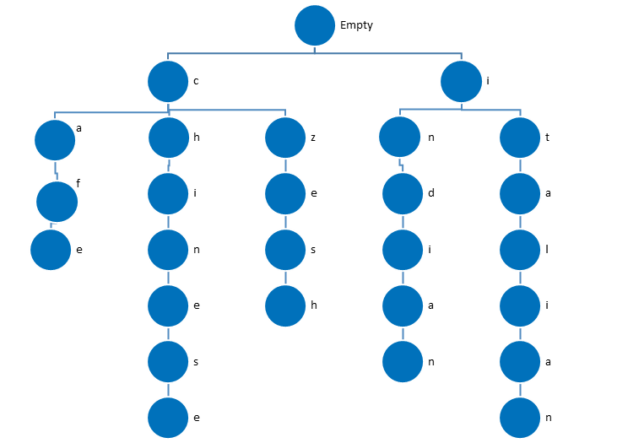
Part 1: Choosing a Data Structure to Search for Food Types:
Trie

Slide 3
TRIE
Tries are efficient to retrieve strings ( words).
Tries do not need a hash function, because every char is a key that can be represented in order, and is uniquely retrievable. Every branch path to a string’s value will be unique . There is no collision, the key is used as the index of the array of children .

Slide 4
Implementation of the Trie
Each node is a Trie:
Value: letter
Children: array of 26 tries, one for each character in the alphabet. Null if the character is not part of a word.
End_of_word: True, if value is end of a word. False otherwise.

Slide 5
Runtime of searching in a Trie
The runtime of searching a food type in the Trie will depend of how many unique character the food- type has the worst case scenario is for the longest word and how many words start with the same characters.
Runtime: O(n*m)
Where n is the length of the longest unique string , and m is how many strings start with the same beginning.

Slide 6
Searching for a food type
More than one type starting with the same beginning(m)
while more_than_one_choice:
user_input = str(input("\nWhat type of food would you like to eat?\nType the beginning of that food type and press enter to see if it's here.\n")).lower()
#Search for user_input in food types data structure here
list_rest=[]
list_children=food_types.get_children()
word=""
found=True
for ind_char,char in enumerate(user_input):
key=food_types.convert_key(char)
if not list_children[key]:
found = False
break
else:
word+=str(char)
if ind_char!=len(user_input)-1:
Each letter enter (n)

Slide 7
Examples of runtime
For Italian the runtime will be O(2*2)
Two words that start with i (indian and italian), and 2 chars (it) entered the second time to find specifically Italian

Slide 8
Better runtime?:
The hash table has a better runtime because the key is the beginning of the food type, and all the food types starting with the same letter are together. There is no many collision, so looking at the list of food types starting with the same letter is faster, and the worst case is that you need all the characters of the type.
The runtime is O(1*n).
Where n is the number of characters to identify the unique type

Slide 9
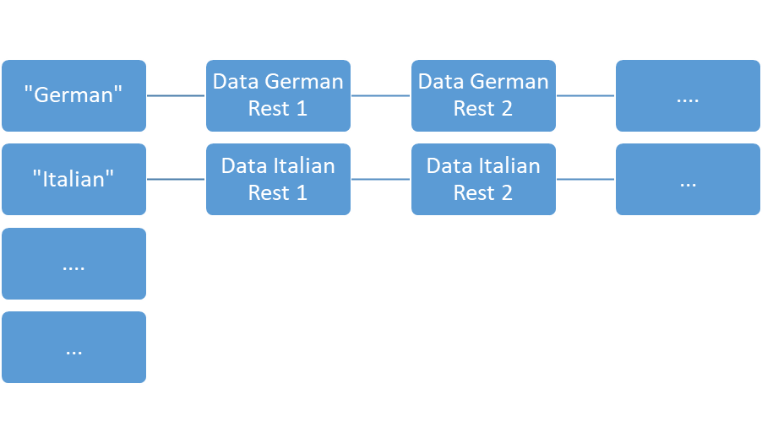
Part 2: Choosing a Data Structure to Retrieve Restaurant Data
Hash Table

Slide 10
HASH TABLE
Hash tables create a mapping, between two sets of data. A key in one set of data is used to access the value/ values associated with it from the other set of data.
A hash function is needed and all collisions are bunched together.

Slide 11
Implementation of the hash table
An array of keys, of a maximum number of keys determined by the application. The key is the type of food.
Every element on the array is a linked list of all the restaurants of the type converted to that key
Implementation provided.

Slide 12
Runtime of searching on the hash table
The hash function creates a key that allows to access directly all the restaurants of that type.
Runtime :
O(1)

Slide 13
Searching for restaurants of a given type
key=list_rest[0]
rest_addresses=restaurant_types.retrieve(key)

Slide 14
Better runtime?:
There is no a better runtime, the other proposed data structures, linkedlist of linkedlists has a runtime of
O(n)
Where n is the number of different food types. The worst case scenario is that the food type to look for, is the last on the list.

Slide 15
Proposed use of the data structures
Hardware Store materials. Use for buyers looking at tools.
Data Structure: Trie. Holds all the different materials found on the hardware store .
Node:
Value: character of the name
Children: []*26.
End_of _word: can hold a numerical value: -1=doesn’t exist, 0=out of stock, 1=on stock
Data Structure: Hash Table. Holds all the different types, or brands
Pair:
Key: name of the material
Value: brand, size, material made of, etc.

Slide 16
Proposed use of the data structures
A library. Search of books by members of the library.
Data Structure: Trie. Holds all the different author names found at the library.
Node:
Value: character of the name
Children: []*26.
End_of _word: can hold a numerical value: -1=doesn’t exist, 0=reserved, 1=on shelf
Data Structure: Hash Table. Holds all the different types, or brands
Pair:
Key: name of the author
Value: name of the book, year, category, location code, etc.

